Slide 1

DELOITTE CAPSTONE 2027 | TEAM DARKTRACE
ClauseIQ: AI Contract Intelligence
Transforming slow, manual contract reviews into fast, auditable AI workflows.

Slide 2
THE BOTTLENECK
The Cost of Manual Review
>50%
~9%
Zero
Time wasted on standard, low-risk clauses.
Annual revenue lost to poor contract management.
Centralized visibility into live compliance obligations.

Slide 3







INTRODUCING CLAUSEIQ
Fast, Auditable, Grounded AI
Automated Extraction
Lifecycle Tracking
Risk Flagging
Grounded AI
Screens terms against predefined industry checklists.
Zero hallucinations. Exact source text citations via RAG.
Reads dense language for plain-English summaries.
Live dashboard for renewals, expiries, and obligations.

Slide 4

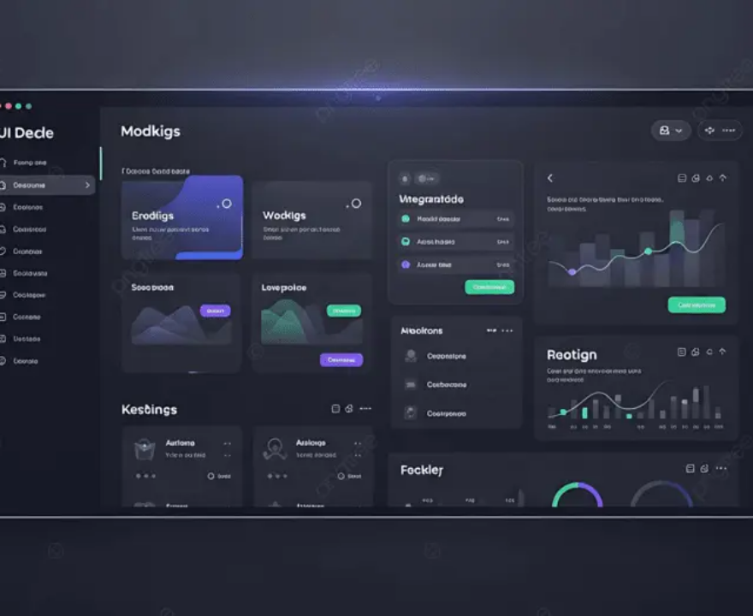


INTERFACE
Unified Contract Dashboard
Built for Legal, Procurement, and Finance teams to operate from a single source of truth.

Slide 5







ENGINEERING
Modular Four-Layer Architecture
1. Interface Layer
2. Processing Layer
3. Intelligence Layer
4. Data Layer

Slide 6


DATA STRATEGY
Managing Relational & Semantic Data
Relational (PostgreSQL)
Semantic (Vector DB)
Stores structured audit trails, strict access controls, and operational metrics.
Stores high-dimensional text embeddings enabling RAG and semantic search.
Users & Contract Access (RLS)
Contract Metadata & Status
Document Embeddings
Vector search maps user queries to exact contract clauses instantly, powering hallucination-free AI generation.
Extracted Clauses & Risk Flags
Key Dates & Milestones

Slide 7




PIPELINE
End-to-End Workflow
01. Ingest
02. Analyze
03. Track
Users upload digital files. System performs OCR and text sanitization.
Text embedded into Vector DB. LLM evaluates against custom compliance policies.
Dashboard populated with summaries, exact risk citations, and active deadlines.

Slide 8


TRUST & PRIVACY
Enterprise-Grade Security
 Strict Access Control Row-Level Security (RLS) and JWT authentication.
 End-to-End Encryption TLS for transit, Server-Side Encryption (SSE) at rest.
 Zero-Retention LLMs Enterprise APIs ensure data never trains public models.
 Regulatory Alignment Architecture designed for strict DPDP and GDPR compliance.

Slide 9
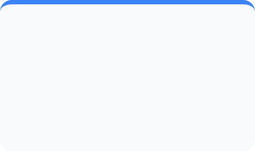


PROACTIVE INTELLIGENCE
Smart Routing for Critical Deadlines
Automated background scanners monitor PostgreSQL key dates, routing targeted alerts to the appropriate department.
Legal & Procurement
Finance Team
Compliance Team
60, 30, and 7-day countdown alerts for contract expirations or auto-renewals.
Prompted 15 days before major payment milestones or scheduled fee escalations.
Immediate systemic alerts if uncapped liabilities or severe risks are uploaded.

Slide 10




EXECUTION
10-Week Delivery Roadmap
Weeks 1-2
Weeks 3-4
Weeks 5-6
Weeks 7-10
Setup, database schemas, and OCR text ingestion pipeline.
Implement RAG pipeline, clause detection, and risk flags.
Build tracking dashboard and personalized notification engine.
Security hardening, edge-case testing, and final demo prep.

Slide 11

Thank You
Questions & Discussion
Team DarkTrace | Deloitte Capstone 2027

Slide 12



Image Sources
https://png.pngtree.com/thumb_back/fw800/background/20251217/pngtree-modern-tech-linkedin-cover-with-network-lines-image_20861259.webp
Source: pngtree.com
https://png.pngtree.com/thumb_back/fw800/background/20260416/pngtree-modern-dark-mode-admin-dashboard-user-interface-design-with-creative-data-image_21720633.webp
Source: pngtree.com
https://png.pngtree.com/thumb_back/fw800/background/20260415/pngtree-digital-cybersecurity-shield-protection-icon-in-high-tech-server-room-with-image_21719500.webp
Source: pngtree.com

